Slide 1

Slide 1
Bitcoin Time Series Price Forecasting
Professor:
Stefano Ferretti
Presented By:
Yellam Naidu Kottavalasa
Usha Padma Rachakonda

Slide 2

Introduction
The most recent technology for establishing and spending digital assets is distributed ledger technology (DLT), and its most well-known application is the cryptocurrency named Bitcoin.
Bitcoin has sparked a gigantic interest in cryptocurrency and blockchain technology.
The inception of Bitcoin, cryptocurrency has gained the trust of the general population.
Bitcoin market capitalization is more than 134 billion US dollars.

Slide 3

Data Collection
The dataset provides the history of the daily prices of Bitcoin.
It contains information about the out-price dynamics of bitcoin against the USD that is, the opening and closing price of each day, the low and high price of each day as well as the volume traded on that day.
This data was obtained from yahoo finance (https://finance.yahoo.com/quote/BTC-USD/history?p=BTC-USD)
The data starts from 17-Sep-2014 to 19-Feb-2022. The dataset contains Date, Open, High, Low, Close, Adj Close, and Volume columns

Slide 4
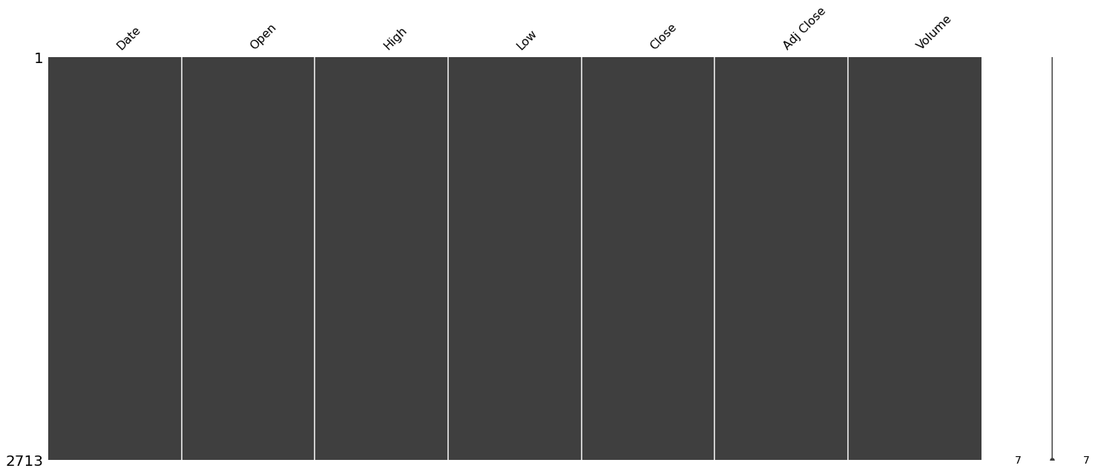
Data Analysis
Missing Values Imputation
In this dataset, there are no missing values in each column.

Slide 5
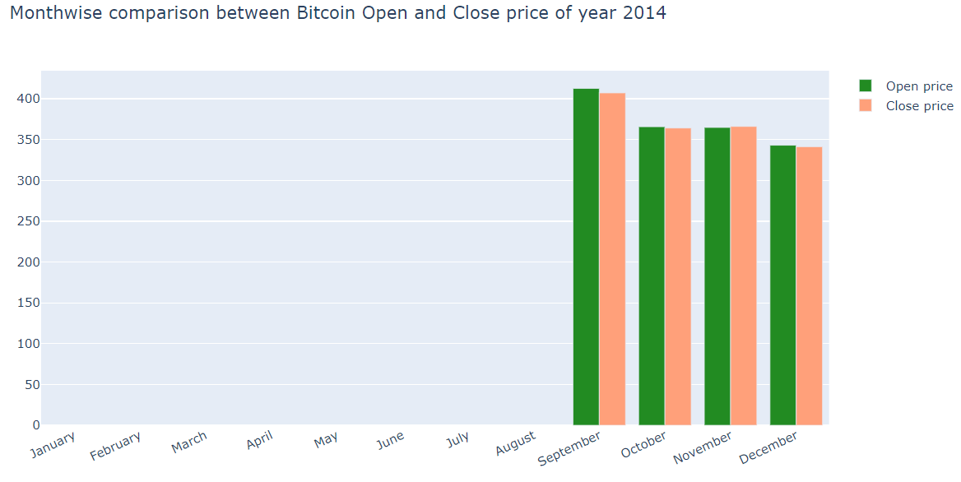
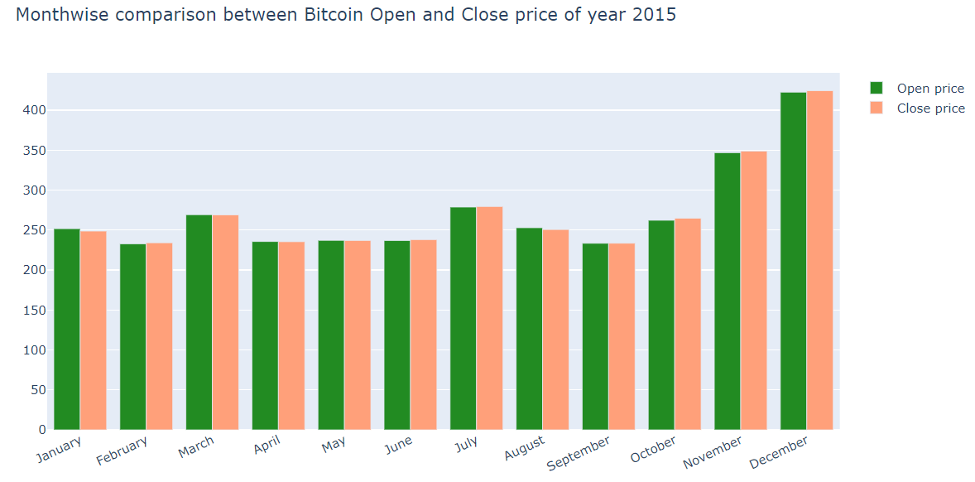
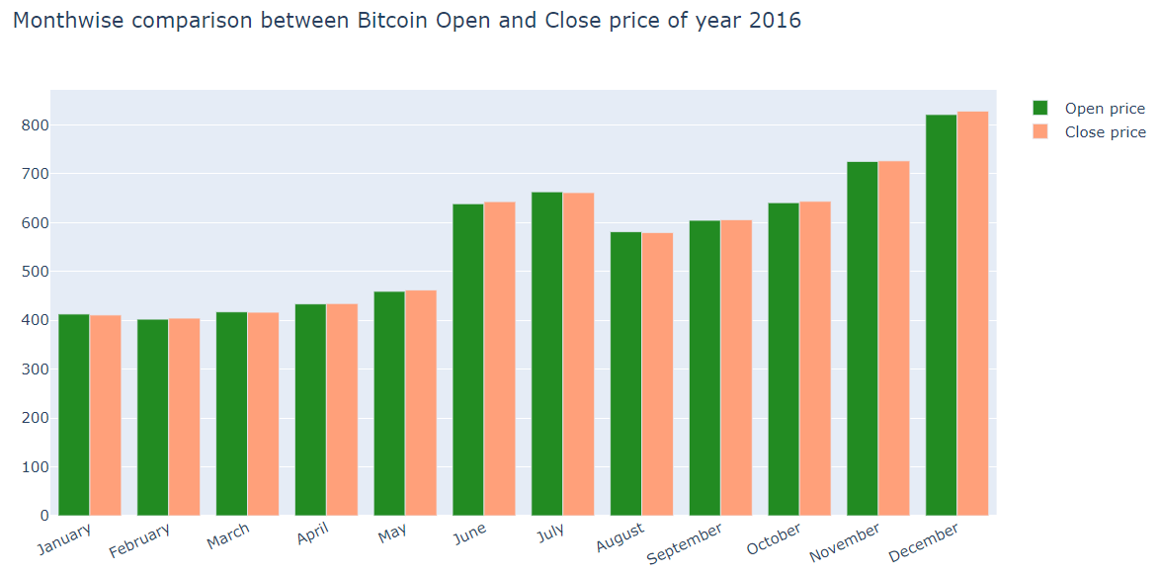
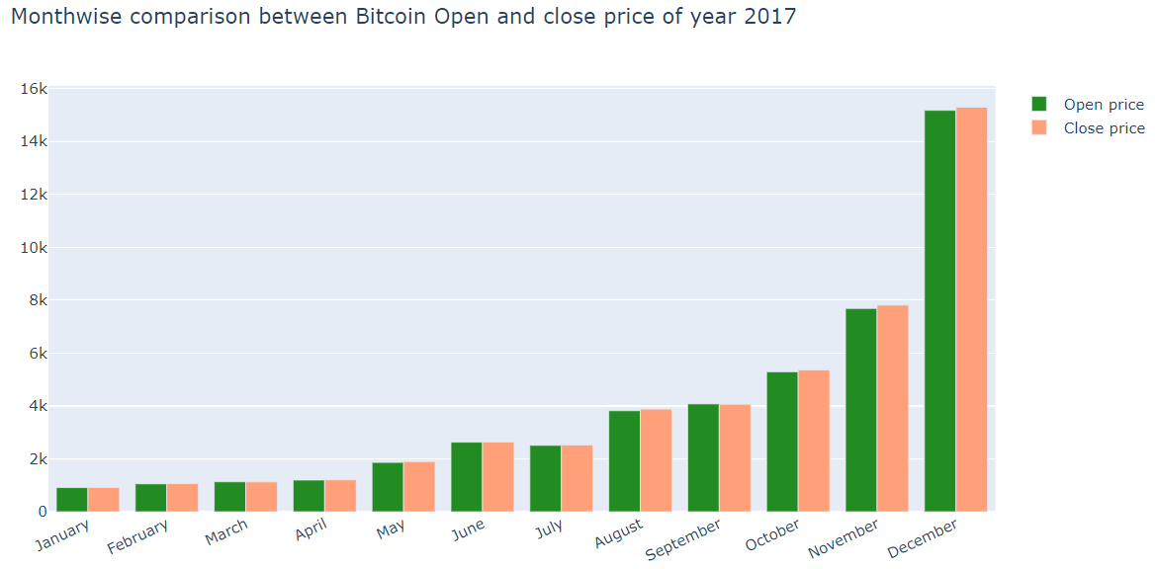
Month wise comparison between bitcoin close and open price.

Slide 6
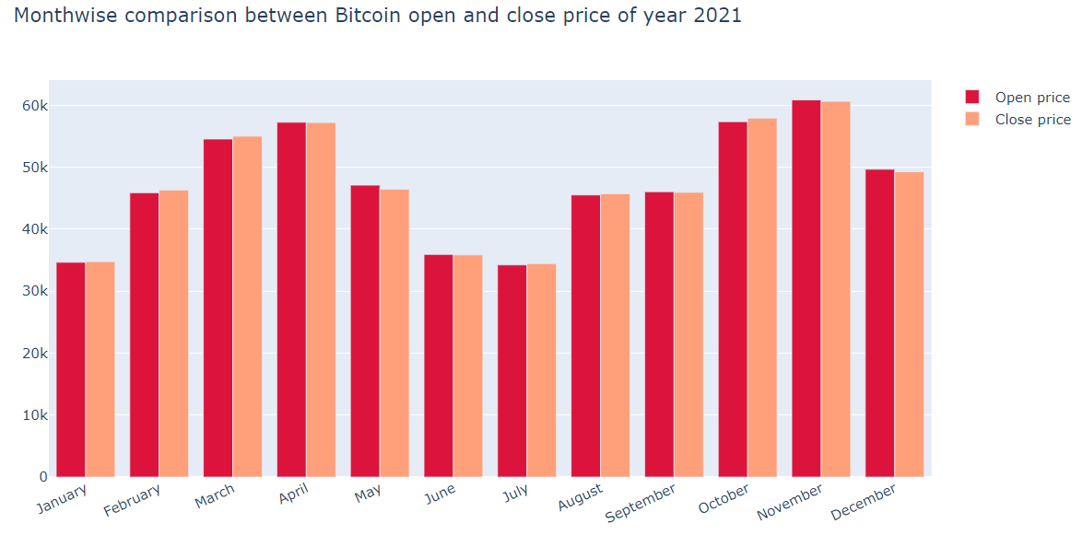
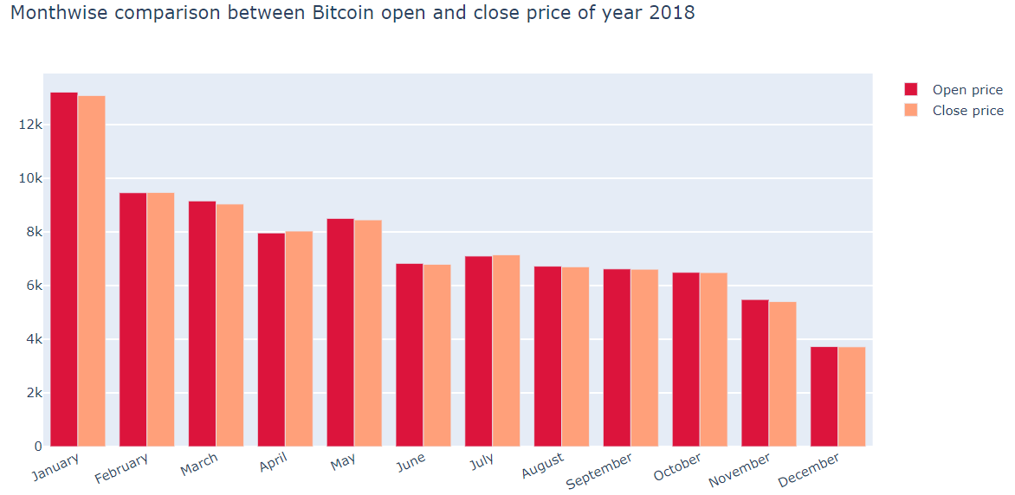
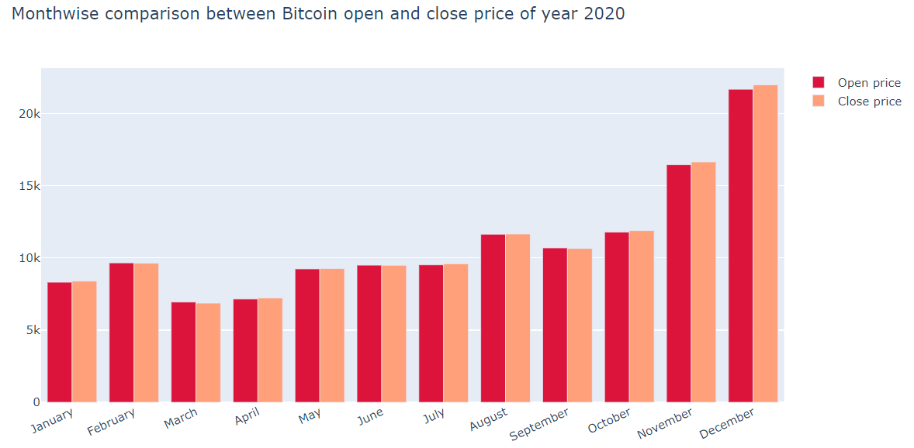
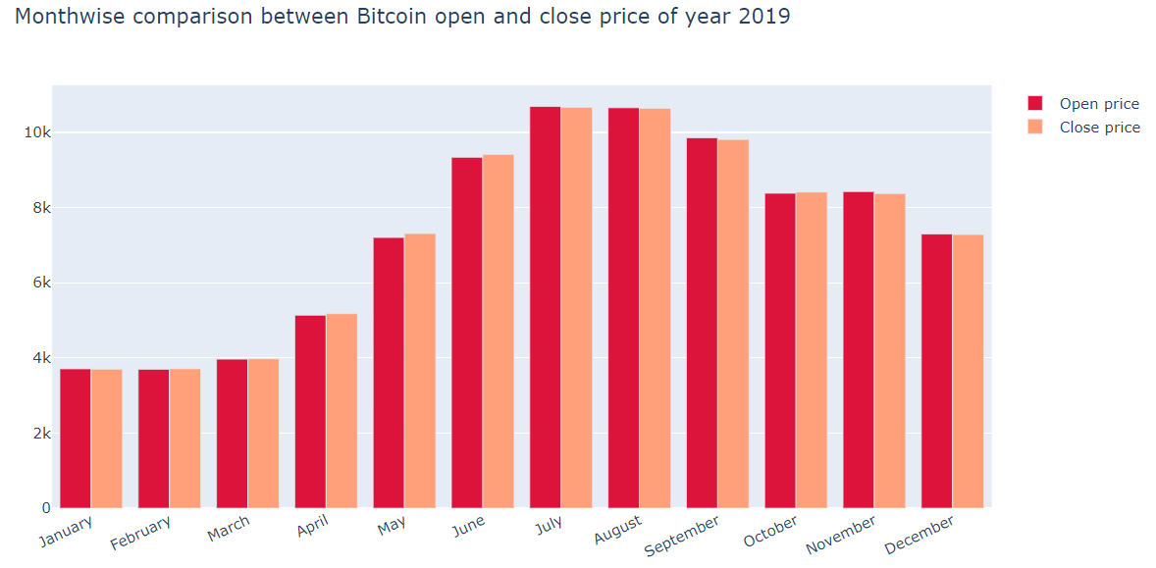
Month wise comparison between bitcoin close and open price.

Slide 7
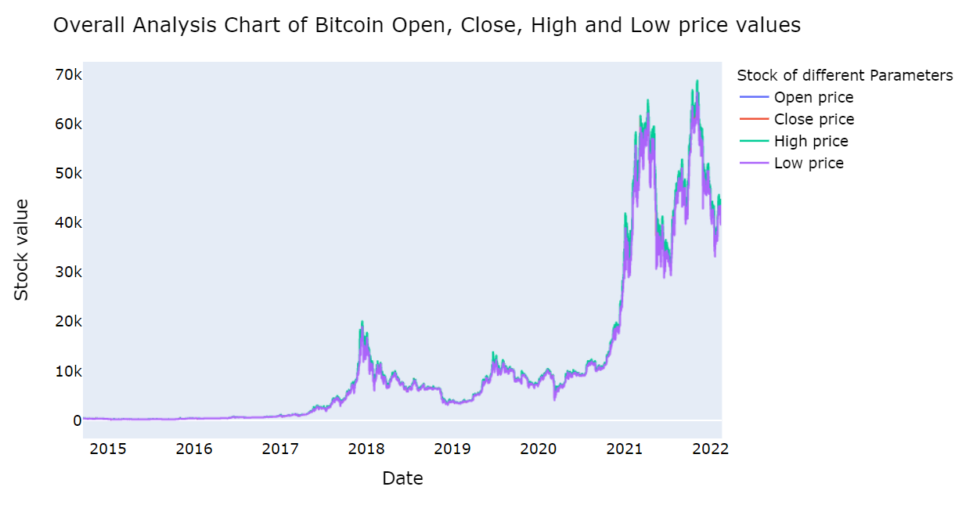
Overall Analysis chart of Bitcoin Open, Close, High, and Low-Price values

Slide 8

Forecasting Models Background
A time series is a sequence of observations measured sequentially through time.
The observations at different moments in the series correlate with each other in different ways.
Time-series forecasting enables us to predict likely future values for a dataset based on historical time-series data.
Time-series data collectively represents how a system, process, or behavior changes over time.
There are several models used for time series forecasting that can be classified as linear and non-linear, univariate, and multivariate.
Linear models are restricted by their assumption of linear behavior in parameters and/or variables, whereas non-linear models may fit more complex dynamics and functions accurately.

Slide 9
Forecasting Models
Models to predict the time series price forecasting.
Convolution Neural Networks
Long Short-Term Memory (LSTM)
Bidirectional LSTM
Gated Recurrent Units
Bidirectional GRU

Slide 10
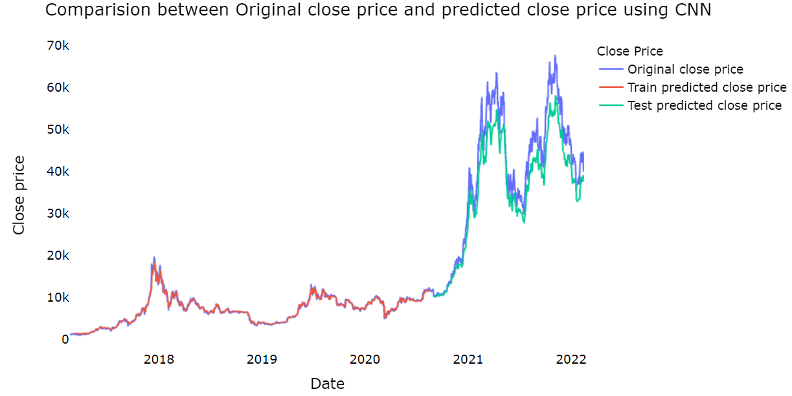
Convolutional Neural Networks (CNN)
A CNN typically has three layers a convolutional layer, a pooling layer, and a fully connected layer.
The convolution layer is the core building block of the CNN. It carries the main portion of the network’s computational load. The pooling layer replaces the output of the network at certain locations by deriving a summary statistic of the nearby outputs.

Slide 11

Long Short-Term Memory (LSTM)
LSTM networks are well-suited to classifying, processing, and making predictions based on time series data.
An LSTM has a similar control flow as a recurrent neural network.
It processes data passing on information as it propagates forward.

Slide 12
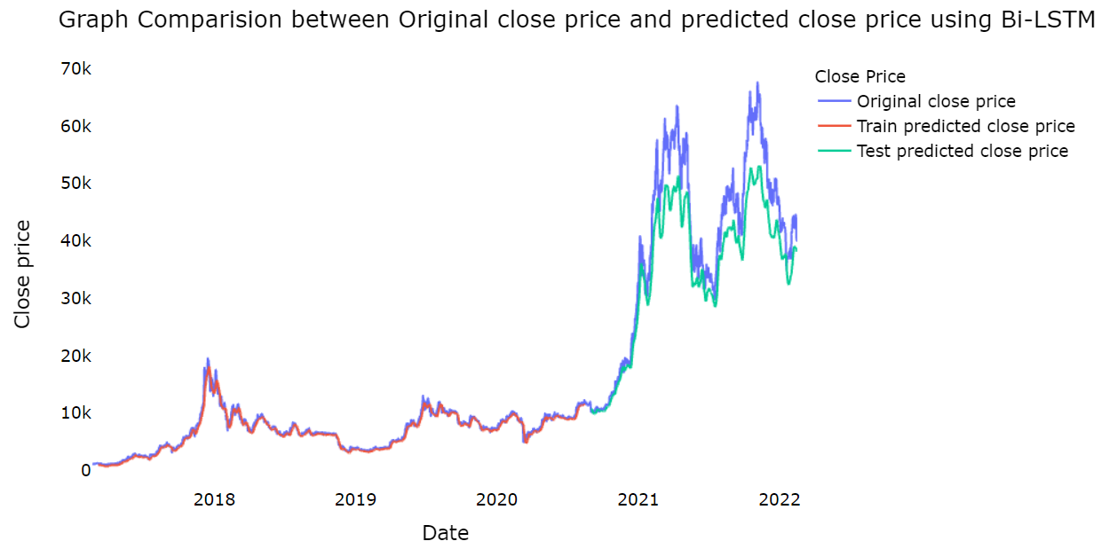
Bidirectional Long Short-Term Memory (Bi-LSTM)
Bidirectional Long short-term memory is a process of making any neural network have the sequence information in both directions backward (future to past) or forward (past to future).
In Bidirectional-LSTM, we can make the input flow in both directions to preserve the future and the past information.

Slide 13
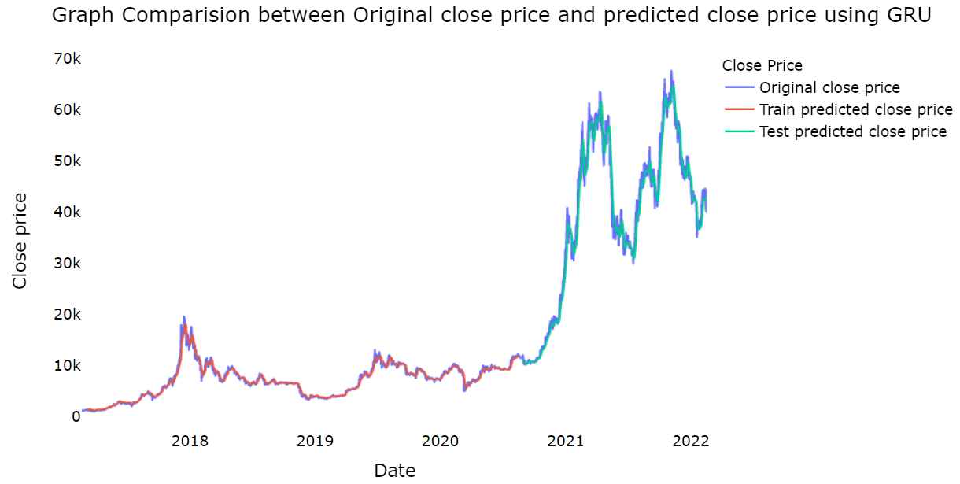
Gated Recurrent Units (GRU)
The GRU is the newer generation of Recurrent Neural networks (RNN) and is pretty much like an LSTM.
GRU uses gating mechanisms to control and manage the flow of information between cells in the neural network.
GRUs got rid of the cell state and used the hidden state to transfer information.

Slide 14
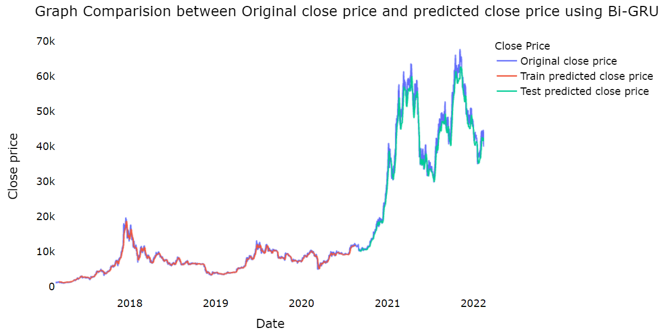
Bidirectional-Gated Recurrent Units (GRU)
Models with Bi-directional structures can learn information from previous and subsequent data when dealing with the current data.
The bi-GRU model is determined based on the state of two GRUs, which are unidirectional in opposite directions. One GRU moves forward, beginning from the start of the data sequence, and the other GRU moves backward, beginning from the end of the data sequence.
This allows the information from both the future and past to impact the current states

Slide 15
Comparing Results of models
 | RMSE | MSE | MAE | R2 Score
CNN | 5232.02 | 27374017.20 | 4387.37 | 0.88
LSTM | 8255.16 | 68147705.60 | 6988.87 | 0.72
Bi-LSTM | 6406.97 | 41049392.91 | 5199.89 | 0.83
GRU | 2604.54 | 6783632.43 | 1955.65 | 0.97
Bi-GRU | 2625.24 | 6891926.65 | 2017.39 | 0.96

Slide 16
Conclusion
Machine learning techniques have recently gained a lot of popularity among the international community.
The GRU predictions have better precision results in terms of forecasting errors are RMSE (), MSE (), MAE (), and R2 Score (), this model gives better forecasting error values when compared to the other models.
We concluded that the GRU approach by large outperforms the other model outputs as previously mentioned.

Slide 17
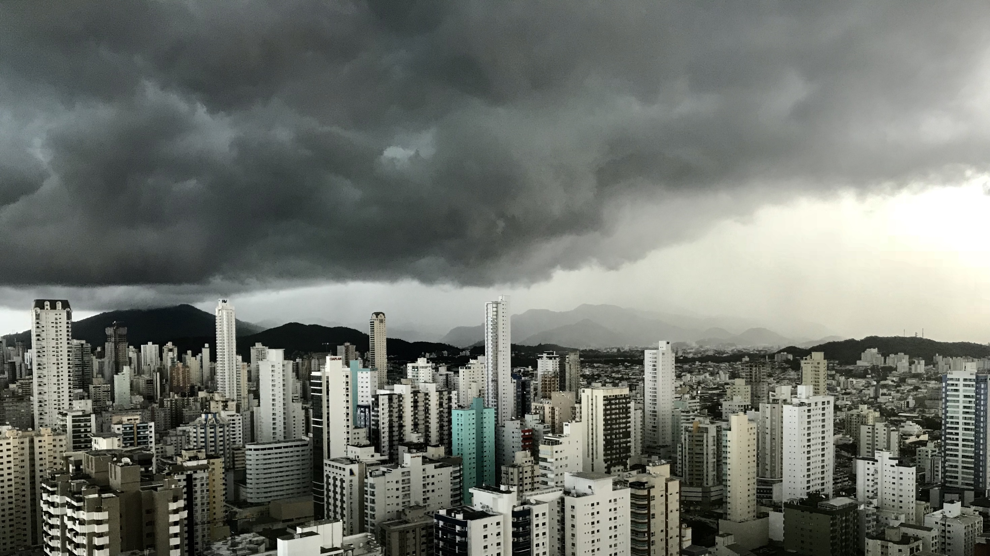
Slide 11
THANK YOU

